Slide 1



Slide 2
Content
Introduction to MySQL
Installation
Connecting and Disconnecting
DDL, DML and DCL Statements
Entering Basic Queries
Creating and Using a Database
Notes:
Audio Script:
GD Instruction:

Slide 3
Introduction to MySQL

Slide 4
MySQL
MySQL is a very popular, open source DBMS
MySQL databases are relational
Officially pronounced “my Ess Que Ell” (not my sequel).
Handles very large databases;
Very fast performance; reliable.
MySQL is compatible with standard SQL
Why are we using MySQL?
Free (much cheaper than Oracle!) Each student can install MySQL locally.
Multi-user access to a number of databases offered
Easy to use Shell for creating tables, querying tables, etc.
Easy to use with Java JDBC
MySQL is frequently used by PHP and Perl
Commercial version of MySQL is also provided (including technical
Notes:
Audio Script:
GD Instruction:

Slide 5
History of MySQL
Founded and developed by David Axmark, Allan Larsson, and Michael “Monty” Widenius
Named after Monty's daughter, My
MySQL Dolphin logo is “Sakila”, the name of a town in Arusha, Tanzania
Written in C and C++
Works on many different platforms
Sun acquired MySQL AB in Jan 2008 for $1 billion dollars
Notes:
Audio Script:
GD Instruction:

Slide 6
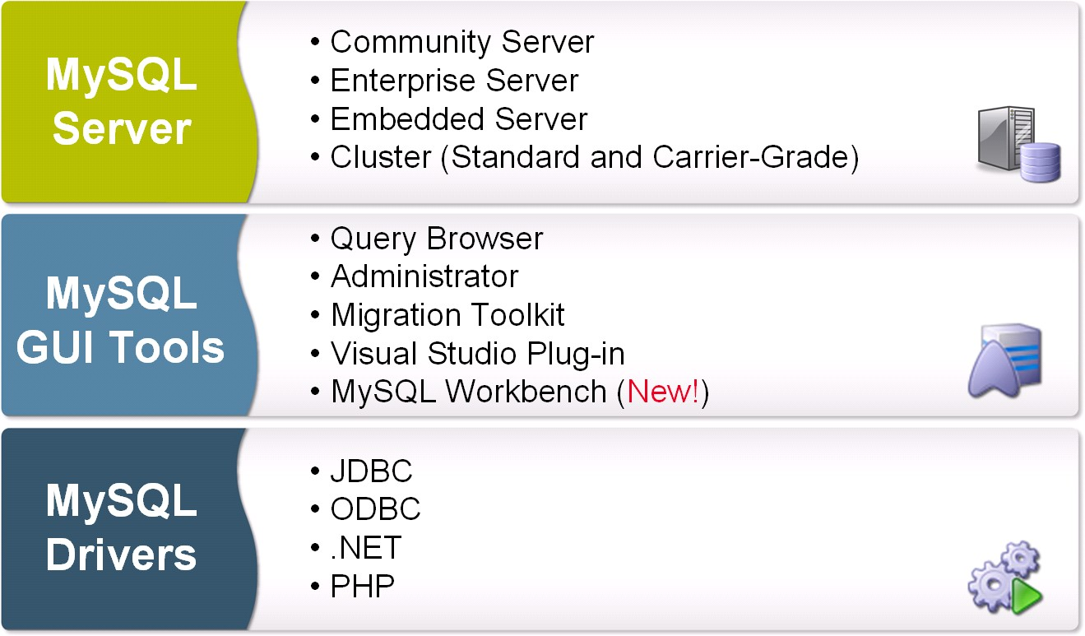
MySQL Products Overview
Notes:
Audio Script:
GD Instruction:

Slide 7
MySQL: characteristics
MySQL Server works in:
client/server systems → a system that consists of a multi-threaded SQL server that supports different backends, several different client programs and libraries, administrative tools, and a wide range of application programming interfaces (APIs).
embedded systems → provide MySQL Server as an embedded multi-threaded library that can be linked into an application to get a smaller, faster, easier-to-manage standalone product.
Notes:
Audio Script:
GD Instruction:

Slide 8
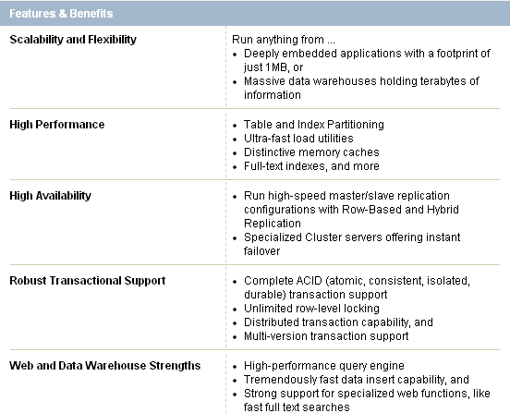
MySQL: Features & Benefits
Notes:
Audio Script:
GD Instruction:

Slide 9
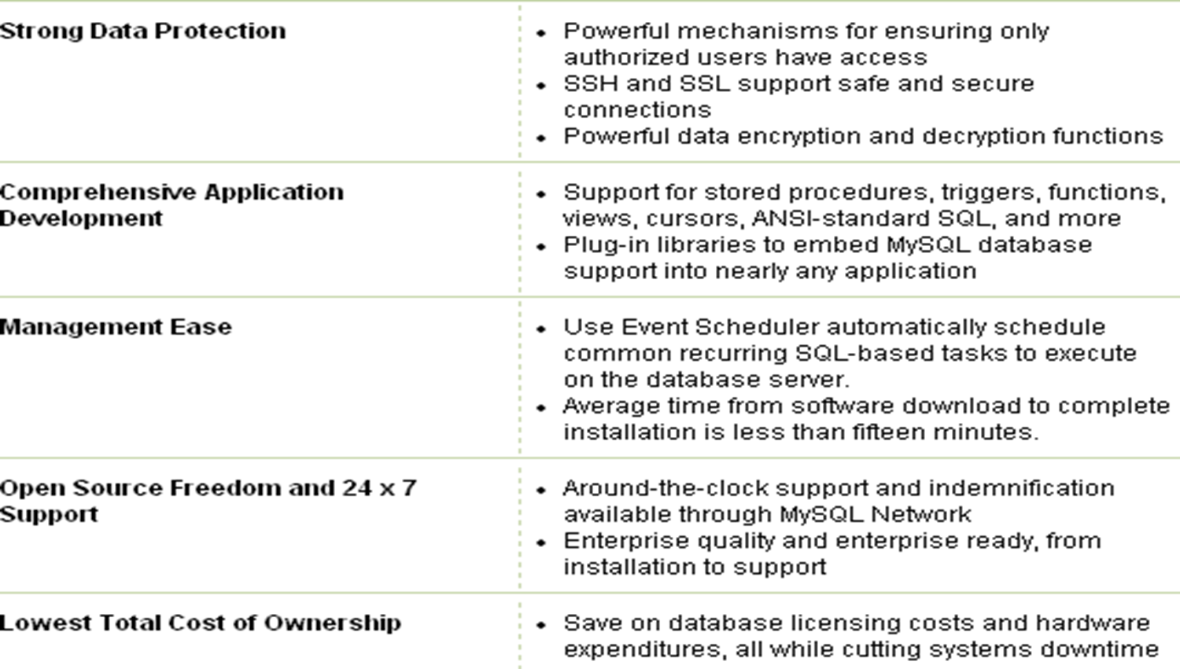
MySQL: Features & Benefits
Notes:
Audio Script:
GD Instruction:

Slide 10
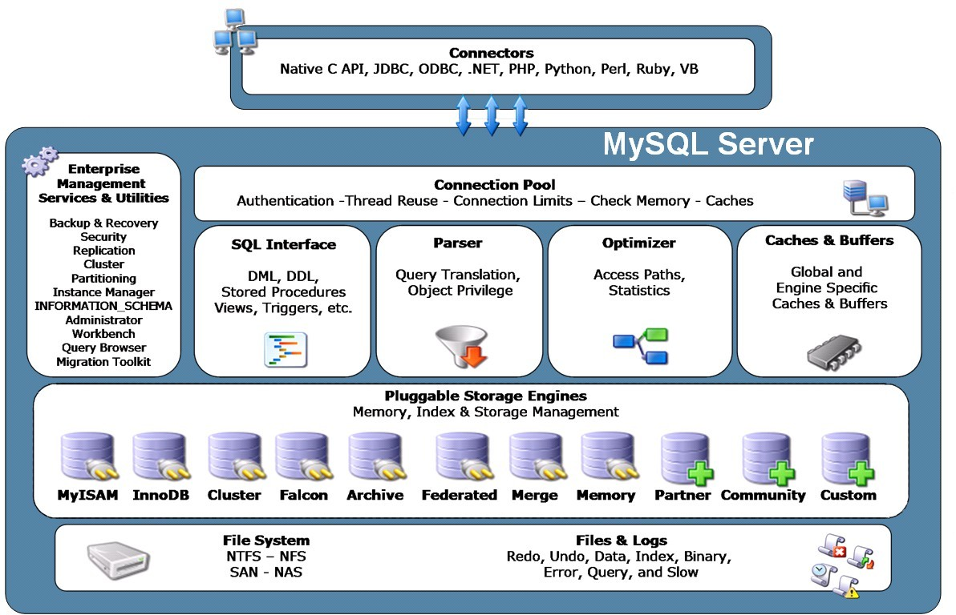
MySQL: Architecture
Notes:
Audio Script:
GD Instruction:

Slide 11
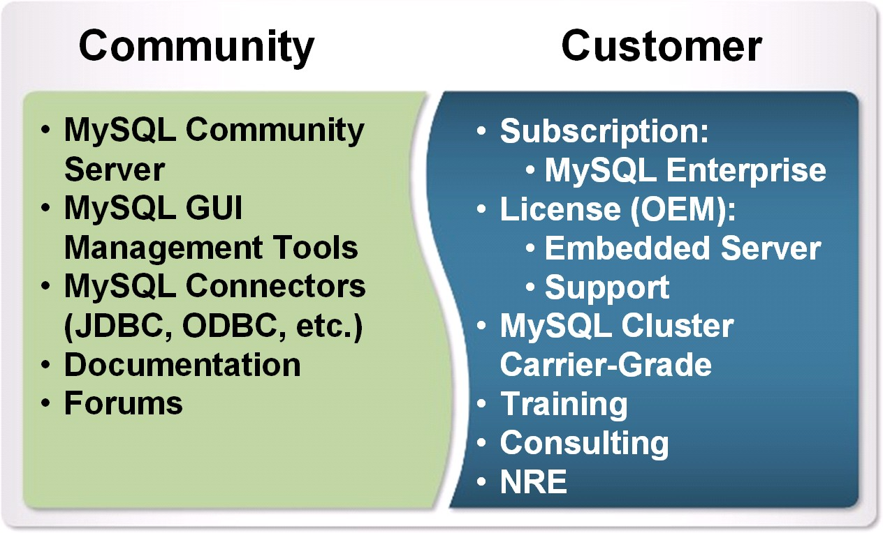
MySQL: Community & Customer
Notes:
Audio Script:
GD Instruction:

Slide 12
Installing MySQL

Slide 13
MySQL: Installation
MySQL is a free, open-source relational database.
https://dev.mysql.com/doc/mysql-installation-excerpt/5.7/en/
Notes:
Audio Script:
GD Instruction:

Slide 14
Connecting and Disconnecting to/from MySQL

Slide 15
Conventions
Commands meant to be executed from within a particular, for example: shell>root-shell> is similar but should be executed as root
MySQL> indicates a statement that has to be executed from the MySQL client program
SQL keywords are not case sensitive
Notes:
Audio Script:
GD Instruction:

Slide 16
Connecting to MySQL
MySQL provides an interactive shell for creating tables, inserting data, etc.
On Windows, just go to c:\mysql\bin, and type:
MySQL or
MySQL -u user -p;
Or, click on the Windows icon
Notes:
Audio Script:
GD Instruction:

Slide 17
Sample Session
For Example:
Enter Password: *****
Welcome to the MySQL monitor. Commands end with ; or \g. Your MySQL connection id is 241 to server version: 3.23.49
Type 'help;' or ‘\h' for help. Type ‘\c' to clear the buffer.
mysql>
To exit the MySQL Shell, just type QUIT or EXIT:
mysql> QUIT mysql> exit
Notes:
Audio Script:
GD Instruction:

Slide 18
DDL, DML and DCL in MySQL

Slide 19
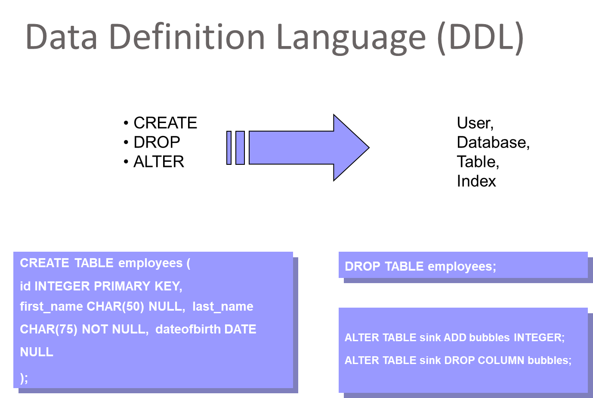
Notes:
Audio Script:
GD Instruction:

Slide 20
Create Table Syntax
CREATE [TEMPORARY] TABLE [IF NOT EXISTS] tbl_name [(definition_create,...)] [options_table] [sentence_select]
CREATE [TEMPORARY] TABLE [IF NOT EXISTS] tbl_name [(] LIKE old_tbl_name [)];
Definition_create
columns_definition
| [CONSTRAINT [symbol]] PRIMARY KEY (index_column_name,...)
| KEY [index_name] (nombre_col_index,...)
| INDEX [index_name] (index_col_name,...)
| [CONSTRAINT [symbol]] UNIQUE [INDEX] [index_name] [index_type] (nombre_col_index,...)
| [FULLTEXT|SPATIAL] [INDEX] [nombre_index] (nombre_col_index,...)
| [CONSTRAINT [símbolo]] FOREIGN KEY [nombre_index] (nombre_col_index,...) [definición_referencia] | CHECK (expr)
columns_definition
column_name type [NOT NULL | NULL] [DEFAULT default_value] [AUTO_INCREMENT] [[PRIMARY] KEY] [COMMENT 'string'] [reference_definition]
reference_definition
REFERENCES table_name [(index_col_name,...)] [MATCH FULL | MATCH PARTIAL | MATCH SIMPLE] [ON DELETE reference_options] [ON UPDATE reference_options]
reference_options
RESTRICT | CASCADE | SET NULL | NO ACTION | SET DEFAULT
Notes:
Audio Script:
GD Instruction:

Slide 21
MySQL column types
TINYINT[(length)] [UNSIGNED] [ZEROFILL]
| SMALLINT[(length)] [UNSIGNED] [ZEROFILL]
| MEDIUMINT[(length)] [UNSIGNED] [ZEROFILL]
| INT[(length)] [UNSIGNED] [ZEROFILL]
| INTEGER[(length)] [UNSIGNED] [ZEROFILL]
| BIGINT[(length)] [UNSIGNED] [ZEROFILL]
| REAL[(length,decimals)] [UNSIGNED] [ZEROFILL]
| DOUBLE[(length,decimals)] [UNSIGNED] [ZEROFILL]
| FLOAT[(length,decimals)] [UNSIGNED] [ZEROFILL]
| DECIMAL(length,decimals) [UNSIGNED] [ZEROFILL]
| NUMERIC(length,decimals) [UNSIGNED] [ZEROFILL]
| DATE | TIME | TIMESTAMP | DATETIME
| CHAR(length) [BINARY | ASCII | UNICODE]
| VARCHAR(length) [BINARY]
| TINYBLOB
| BLOB
| MEDIUMBLOB
| LONGBLOB
| TINYTEXT
| TEXT
| MEDIUMTEXT
| LONGTEXT
| ENUM(value1,value2,value3,...) SET(value1,value2,value3,...)
| spatial_type
Notes:
Audio Script:
GD Instruction:

Slide 22
Data Manipulation Language (DML)
Data Manipulation Language (DML) statements are used for managing data within schema objects DML deals with data manipulation, and therefore includes most common SQL statements such SELECT, INSERT, etc.
DML allows to add / modify / delete data itself. DML is used to manipulate with the existing data in the database objects (insert, select, update, delete).

Slide 23
DML Commands:
1.INSERT 2.SELECT 3.UPDATE 4.DELETE *INSERT: Syntax: INSERT INTO Table name values();
*SELECT: Syntax: Select*from <table name>
*UPDATE: Syntax: Update<table name> set to(calculation);
*DELETE: Syntax: Delete form<table name>

Slide 24
Data Control Language (DCL)
DCL is the abstract of Data Control Language.
Data Control Language includes commands such as GRANT, and concerns with rights, permissions and other controls of the database system.
DCL is used to grant / revoke permissions on databases and their contents.
DCL is simple, but MySQL permissions are a bit complex.
DCL is about security. DCL is used to control the database transaction.
DCL statement allow you to control who has access to specific object in your database.
GRANT
REVOKE

Slide 25
Data Control Language (DCL)
GRANT :It provides the user's access privileges to the database.
In the MySQL database offers both the administrator and user a great extent of the control options.
By the administration side of the process includes the possibility for the administrators to control certain user privileges over the MySQL server by restricting their access to an entire the database or ust limiting permissions for a specific table.It Creates an entry in the security system that allows a user in the current database to work with data in the current database or execute specific statements.

Slide 26
Data Control Language (DCL)
Syntax : Statement permissions:
GRANT { ALL | statement [ ,...n ] } TO security_account [ ,...n ]
Normally, a database administrator first uses CREATE USER to create an account, then GRANT to define its privileges and characteristics.
For example: CREATE USER 'arjun'@'localhost' IDENTIFIED BY 'mypass'; GRANT ALL ON db1.* TO 'arjun'@'localhost'; GRANT SELECT ON child TO 'arjun'@'localhost'; GRANT USAGE ON *.* TO 'arjun'@'localhost' WITH MAX_QUERIES_PER_HOUR 90;

Slide 27
Data Control Language (DCL)
REVOKE : The REVOKE statement enables system administrators and to revoke the privileges from MySQL accounts.
Syntax : REVOKE priv_type [(column_list)] [, priv_type [(column_list)]] ... ON [object_type] priv_level FROM user [, user] ... REVOKE ALL PRIVILEGES, GRANT OPTION FROM user [, user] ... For example:
mysql> REVOKE INSERT ON *.* FROM 'arjun'@'localhost';

Slide 28
Connecting to MySQL
How to use the mysql client
mysql is an interactive program that enables you to:
connect to a MySQL server,
Run queries,
view the results
Mysql may also be used in batch mode:
place your queries in a file beforehand, then tell Mysql to execute the contents of the file
shell> mysql --help
To see a list of options provided by mysql

Slide 29
Entering & Editing commands
Prompt mysql>
issue a command
Mysql sends it to the server for execution
displays the results
prints another mysql>
a command could span multiple lines
A command normally consists of SQL statement followed by a semicolon

Slide 30
MySQL commands
help \h
Quit/exit \q
Cancel the command \c
Change database use
…etc

Slide 31
Basic Queries
Once logged in, you can try some simple queries. For example:
mysql> SELECT VERSION(), CURRENT_DATE;
+-----------+--------------+
| VERSION() | CURRENT_DATE |
+-----------+--------------+
| 3.23.49 | 2002-05-26 |
+-----------+--------------+
1 row in set (0.00 sec)
Note that most MySQL commands end with a semicolon (;)
MySQL returns the total number of rows found, and the total time to execute the query.

Slide 32
Basic Queries
Keywords may be entered in any lettercase.
The following queries are equivalent:
mysql> | SELECT | VERSION(), | CURRENT_DATE;
mysql> | select | version(), | current_date;
mysql> | SeLeCt | vErSiOn(), | current_DATE;

Slide 33
Basic Queries
Here's another query. It demonstrates that you can use mysql as a simple calculator:
mysql> SELECT SIN(PI()/4), (4+1)*5;
+-------------+---------+
| SIN(PI()/4) | (4+1)*5 |
+-------------+---------+
| 0.707107 | 25 |
+-------------+---------+

Slide 34
Basic Queries
You can also enter multiple statements on a single line. Just end each one with a semicolon:
mysql> SELECT VERSION(); SELECT NOW();
+--------------+
| VERSION() |
+--------------+
| 3.22.20a-log |
+--------------+
+---------------------+
| NOW() |
+---------------------+
| 2004 00:15:33 |
+---------------------+

Slide 35
Multi-Line Commands
mysql determines where your statement ends by looking for the terminating semicolon, not by looking for the end of the input line.
Here's a simple multiple-line statement:
mysql> SELECT
-> USER()
-> ,
-> CURRENT_DATE;
+--------------------+--------------+
| USER() | CURRENT_DATE |
+--------------------+--------------+
| joesmith@localhost | 1999-03-18 |
+--------------------+--------------+

Slide 36
Command prompt
prompt | meaning
mysql> | Ready for new command.
-> | Waiting for next line of multiple-line command.
‘> | Waiting for next line, waiting for completion of a string that began with a single quote (“'”).
“> | Waiting for next line, waiting for completion of a string that began with a double quote (“"”).
`> | Waiting for next line, waiting for completion of an identifier that began with a backtick (“`”).
/*> | Waiting for next line, waiting for completion of a comment that began with /*.

Slide 37
Canceling a Command
If you decide you don't want to execute a command that you are in the process of entering, cancel it by typing \ c
mysql> SELECT
-> USER()
-> \c mysql>

Slide 38
Creating, Removing and Getting Information for a Database

Slide 39
Info about databases and tables
Listing the databases on the MySQL server host
mysql>show databases;
Access/change database
mysql>Use [database_name]
Showing the current selected database
mysql> select database();
Showing tables in the current database
mysql>show tables;
Showing the structure of a table
mysql> describe [table_name];

Slide 40
Using a Database
To get started on your own database, first check which databases currently exist.
Use the SHOW statement to find out which databases currently exist on the server (and for which the user has privileges):
mysql> show databases;
+----------+
| Database |
+----------+
| mysql
| test
|
|
+----------+
2 rows in set (0.01 sec)

Slide 41
Using a Database
Create a user
mysql> CREATE USER user
[IDENTIFIED BY 'new-password'];
See “help CREATE USER”
Remove a user
mysql> DROP USER user;

Slide 42
Using a Database
To create a new database, issue the
“create database” command:
mysql> create database webdb;
Note: Database names are case sensitive
To the select a database, issue the “use” command:
mysql> use webdb;
To see what database is selected
mysql> select database();

Slide 43
Creating a Table
Once you have selected a database, you can view all database tables:
mysql> show tables; Empty set (0.02 sec)
An empty set indicates that I have not created any tables yet.

Slide 44
Creating a Table
Let’s create a table for storing pets.
Table: pets
name:
owner:
species:
Gender:
birth:
date:
VARCHAR(20)
VARCHAR(20)
VARCHAR(20)
CHAR(1)
DATE
DATE
VARCHAR is
usually used to store string data.

Slide 45
Creating a Table
To create a table, use the CREATE TABLE command:
mysql> CREATE TABLE pet (
name VARCHAR(20),
owner VARCHAR(20),
species VARCHAR(20),
gender CHAR(1),
birth DATE, death DATE);
Query OK, 0 rows affected (0.04 sec)

Slide 46
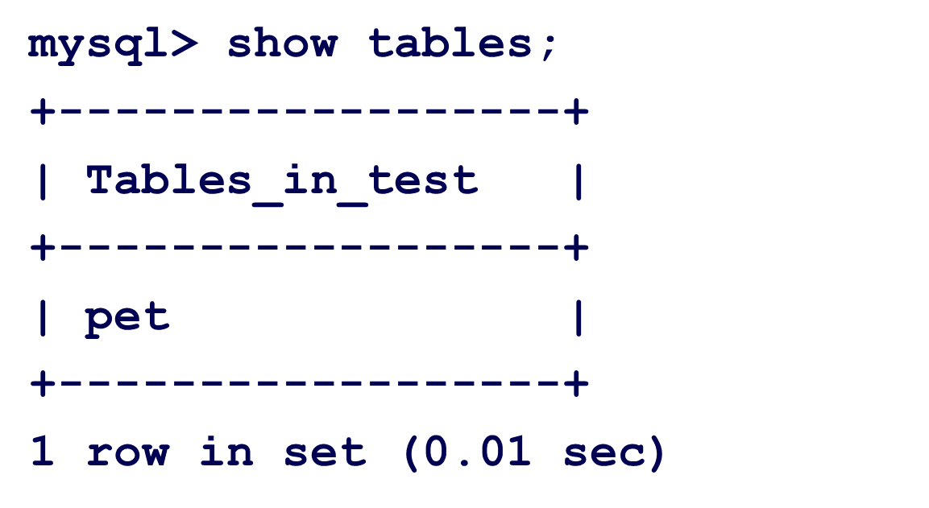
Showing Tables
To verify that the table has been created:

Slide 47
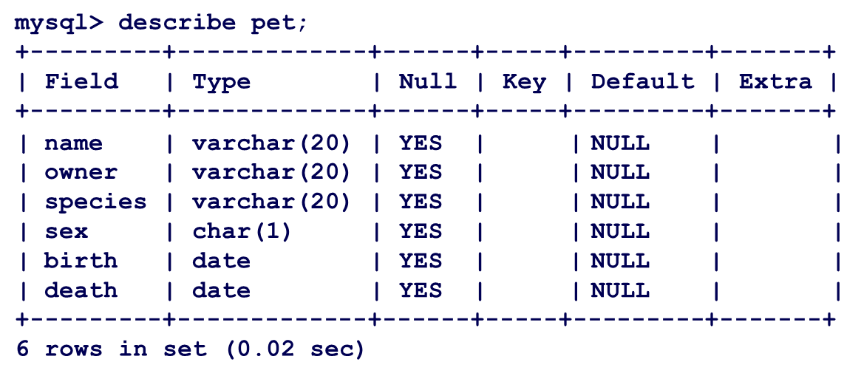
Describing Tables
To view a table structure, use the DESCRIBE command:

Slide 48

Deleting a Table
To delete an entire table, use the DROP TABLE command:

Slide 49
Loading Data
Use the INSERT statement to enter data into a table.
For example:
INSERT INTO pet VALUES ('Puffball','Diane','hamster','f’, '1999-03-30',NULL);
The next slide shows a full set of sample data.

Slide 50
More data…
name | owner | species | gender | birth | death
Fluffy | Harold | cat | f | 1993-02-04
Claws | Gwen | cat | m | 1994-03-17
Buffy | Harold | dog | f | 1989-05-13
Fang | Benny | dog | m | 1990-08-27
Bowser | Diane | dog | m | 1998-08-31 | 1995-07-29
Chirpy | Gwen | bird | f | 1998-09-11
Whistler | Gwen | bird |  | 1997-12-09
Slim | Benny | snake | m | 1996-04-29

Slide 51
For each of the examples
assume the following set of data.
name | owner | species | gender | birth | death
Fluffy | Harold | cat | f | 1993-02-04
Claws | Gwen | cat | m | 1994-03-17
Buffy | Harold | dog | f | 1989-05-13
Fang | Benny | dog | m | 1990-08-27
Bowser | Diane | dog | m | 1998-08-31 | 1995-07-29
Chirpy | Gwen | bird | f | 1998-09-11
Whistler | Gwen | bird |  | 1997-12-09
Slim | Benny | snake | m | 1996-04-29

Slide 52
Manipulating Instances of Tables of a Database

Slide 53
Manipulating Table Instances
Remove records of a table
mysql> DELETE FROM tableName;
[WHERE where_condition];
Update records of a table
UPDATE pet SET birth = '1989- 08-31’ WHERE name ='Bowser';

Slide 54
Querying Tables of a Database

Slide 55
SQL Select
The SELECT statement is used to pull information from a table.
The general format is:
SELECT what_to_select FROM
which_table
WHERE conditions_to_satisfy

Slide 56
Selecting All Data
The simplest form of SELECT retrieves everything from a table
mysql> select * from pet;
+----------+--------+---------+------+------------+------------+
| name | owner | species | gender | birth | death |
+----------+--------+---------+------+------------+------------+
| | Fluffy | | | Harold | | | cat | | | f | | | 1999-02-04 | | | NULL | |
| | Claws | | | Gwen | | | cat | | | f | | | 1994-03-17 | | | NULL | |
| | Buffy | | | Harold | | | dog | | | f | | | 1989-05-13 | | | NULL | |
| | Fang | | | Benny | | | dog | | | m | | | 1999-08-27 | | | NULL | |
| | Bowser | | | Diane | | | dog | | | m | | | 1998-08-31 | | | 1995-07-29 | |
| | Chirpy | | | Gwen | | | bird | | | f | | | 1998-09-11 | | | NULL | |
| | Whistler | | | Gwen | | | bird | | |  | | | 1997-12-09 | | | NULL | |
| | Slim | | | Benny | | | snake | | | m | | | 1996-04-29 | | | NULL | |
+----------+--------+---------+------+------------+------------+
8 rows in set (0.00 sec)

Slide 57
Selecting Particular Rows
You can select only particular rows from your table.
For example, if you want to verify the change that you made to Bowser's birth date, select Bowser's record like this:
mysql> SELECT * FROM pet WHERE name = "Bowser";
+--------+-------+---------+------+------------+------------+
| name | owner | species | gender | birth | death |
+--------+-------+---------+------+------------+------------+
| Bowser | Diane | dog | m | 1998-08-31 | 1995-07-29 |
+--------+-------+---------+------+------------+------------+
1 row in set (0.00 sec)
Try the same select:
without the last (“)
without the last (“) and (;) Try with \c

Slide 58
Selecting Particular Rows
To find all animals born after 1998
SELECT * FROM pet WHERE birth >= "1998-1-1";
To find all female dogs, use a logical AND
SELECT * FROM pet WHERE species = "dog" AND gender = "f";
To find all snakes or birds, use a logical OR
SELECT * FROM pet WHERE species = "snake“ OR species
= "bird";
AND has higher precedence than OR → Use paranthesis if necessary

Slide 59
Selecting Particular Columns
For having only a selection of columns of a table, just name the columns you are interested, separated by commas.
Example: you want to know when your pets were born
– select the name and birth columns.
(see example next slide.)

Slide 60
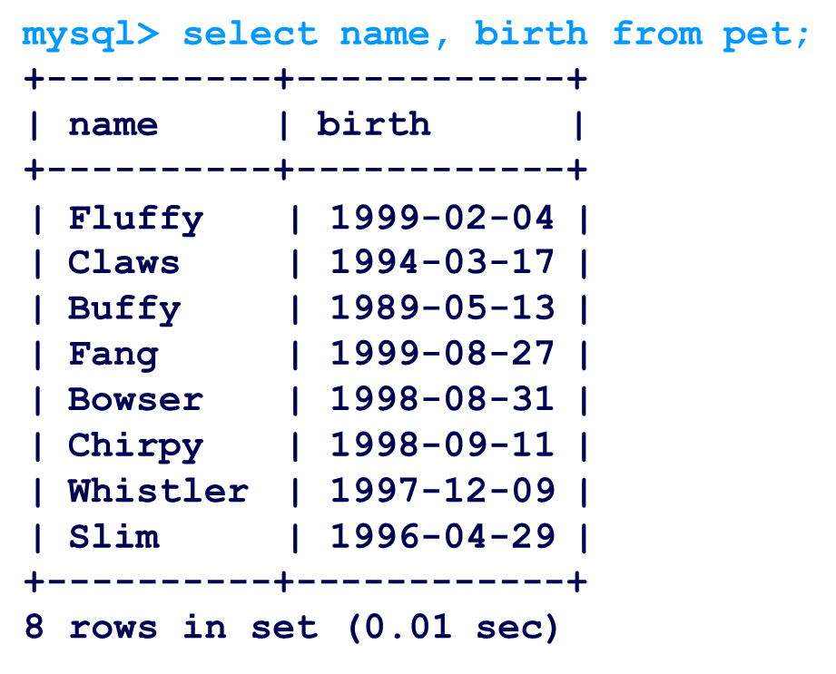
Selecting Particular Columns

Slide 61
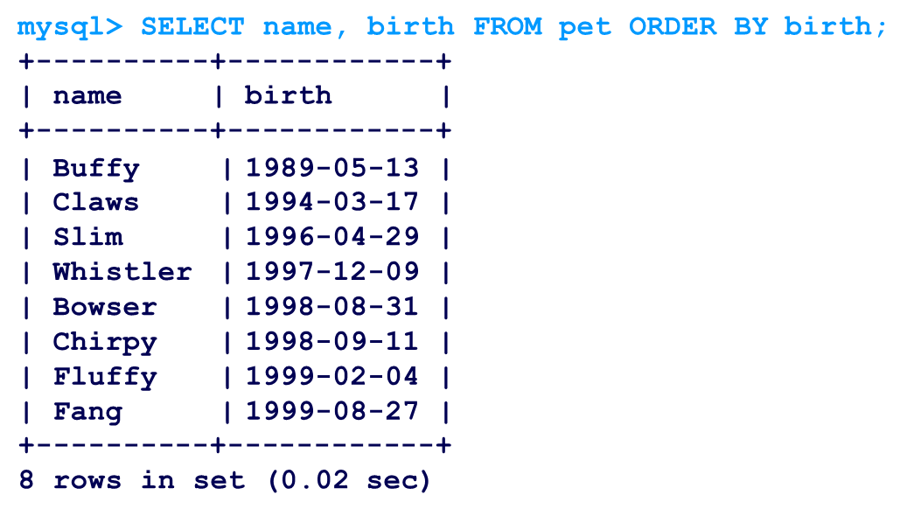
Sorting Data
To sort a result, use an ORDER BY clause.
Example: view animal birthdays, sorted by date:

Slide 62
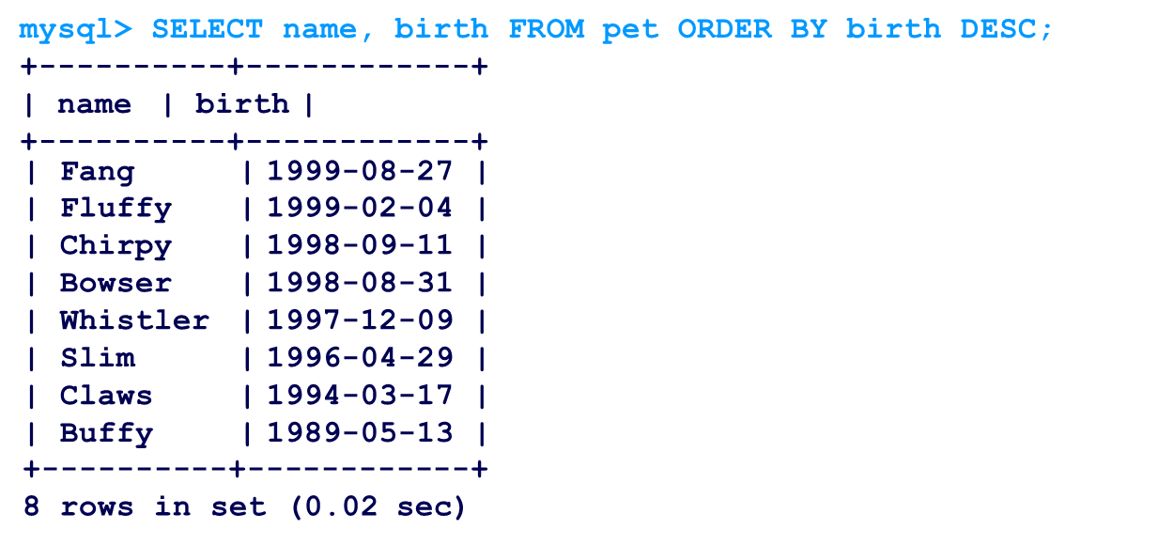
Sorting Data
To sort in reverse order, add the DESC (descending keyword)

Slide 63
Sorting Data
Sorting on multiple columns in different directions
Get name, species, birth with animals in ascending order and date (within animal type) in descending order (youngest first)
mysql> SELECT name, species, birth FROM pet ORDER BY species, birth DESC;
Try the opposite

Slide 64
Selecting Particular Rows
Find out who owns pets
SELECT owner FROM pet;
Find out who owns pets (without duplicate)
SELECT DISTINCT owner FROM pet;
Get birth dates for male dogs and female cats
SELECT name, species, birth FROM pet WHERE (species = "dog" AND gender=”m”) OR (species = "cat" AND gender=”f”);

Slide 65
Working with NULLs
NULL means missing value or unknown value.
To test for NULL, you cannot use the arithmetic comparison operators, such as =, < or <>.
Rather, you must use the IS NULL and IS NOT NULL operators instead.

Slide 66
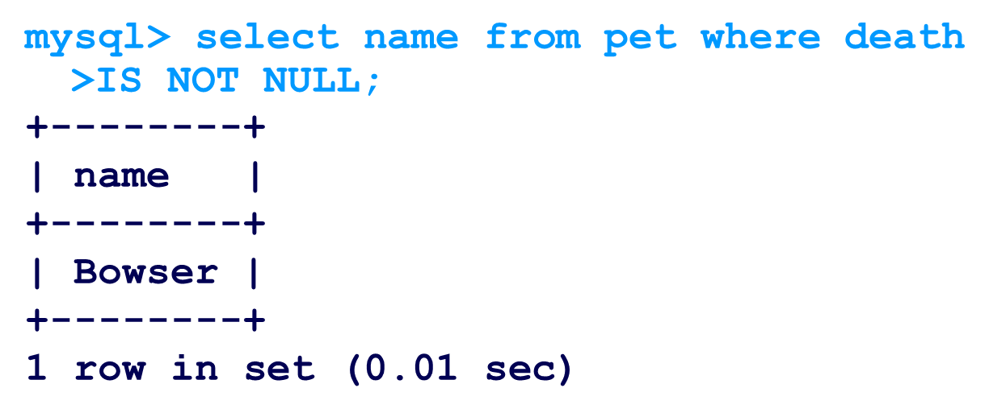
Working with NULLs
Find all your dead pets

Slide 67
Working with NULLs
Two NULL values are regarded as equal in a GROUP BY
Ex.: create a query with a group by on an attribute haing NULL values
NULL values are presented:
first with ORDER BY … ASC
last with ORDER BY ... DESC

Slide 68
Pattern Matching
MySQL provides:
standard SQL pattern matching
regular expression pattern matching
SQL Pattern matching:
To perform pattern matching, use the LIKE or NOT LIKE comparison operators
By default, patterns are case insensitive
Special Characters:
_Used to match any single character.
% Used to match an arbitrary number of characters.

Slide 69
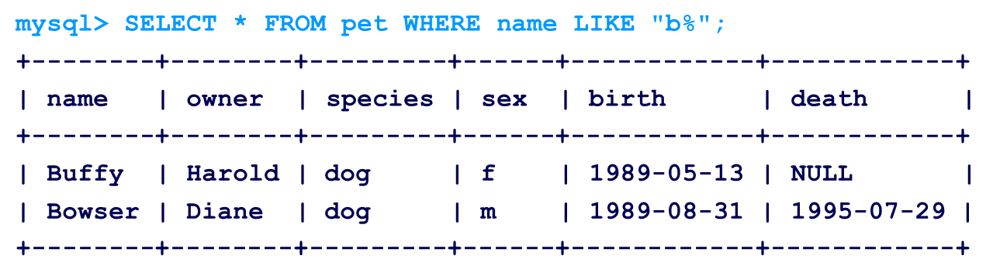
Pattern Matching Example
To find names beginning with ‘b’:

Slide 70
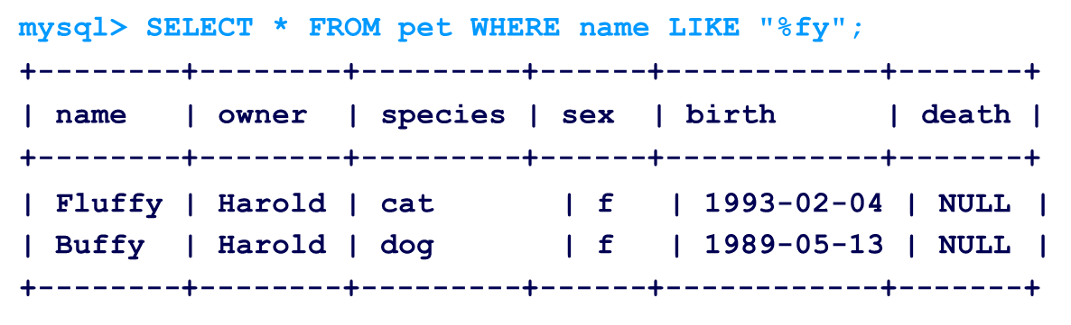
Pattern Matching Example
Find names ending with %fy':

Slide 71
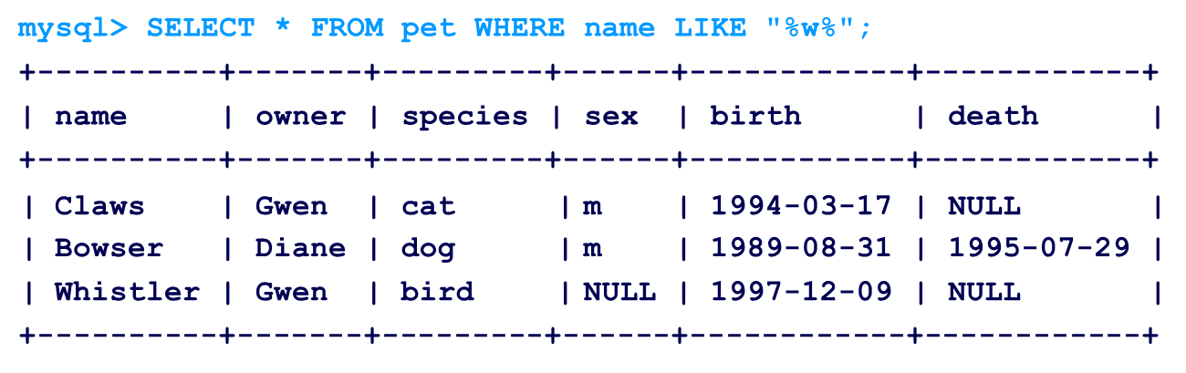
Pattern Matching Example
Find names containing a ‘w’:

Slide 72
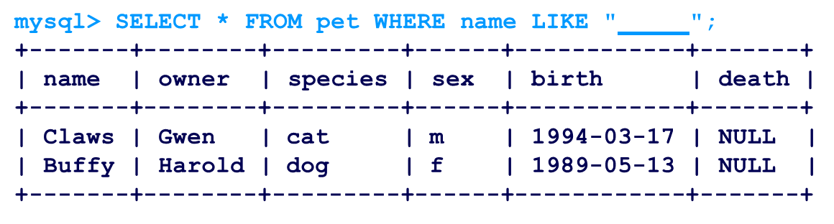
Pattern Matching Example
Find names containing exactly five characters
– use the _ pattern character:

Slide 73
Regular Expression Matching
The other type of pattern matching provided by MySQL uses extended regular expressions.
Testing for a match for this type of pattern, use the REGEXP and NOT REGEXP operators (or RLIKE and NOT RLIKE, which are synonyms).

Slide 74
Regular Expressions
Some characteristics of extended regular expressions:
“.” matches any single character.
A character class [...] matches any character within the brackets.
Example: [abc] matches a, b, or c.
To name a range of characters, use a dash.
[a-z] matches any lowercase letter
[0-9] matches any digit.
“*” matches zero or more instances of the thing preceding it.
Example: x* matches any number of x characters
[0-9]* matches any number of digits
.* matches any number of anything.
To anchor a pattern so that it must match the beginning or end of the value being tested, use ^ at the beginning or $ at the end of the pattern.

Slide 75
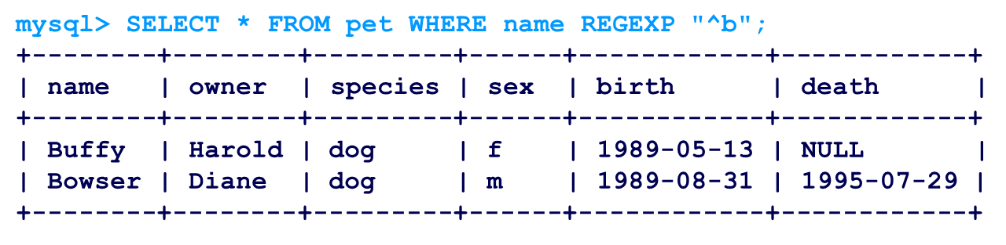
Reg Ex Example
Find names beginning with b,
– use ^ to match the beginning of the name:

Slide 76
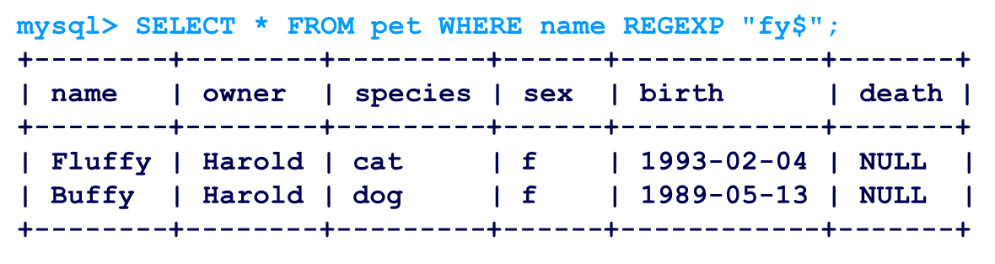
Reg Ex Example
Find names ending with `fy',
– use `$' to match the end of the name:

Slide 77
Counting Rows
Databases often used to answer the question,
"How often does a certain type of data occur in a table?"
Example: 1) how many pets are sored
2) how many pets each owner has
Counting the total number of animals you have is the same question as “How many rows are in the pet table?” because there is one record per pet.
The COUNT() function counts the number of non- NULL results

Slide 78
Counting Rows Example
A query to determine total number of pets:
mysql> SELECT COUNT(*) FROM pet;
+----------+
| COUNT(*) |
+----------+
| 9 |
+----------+

Slide 79
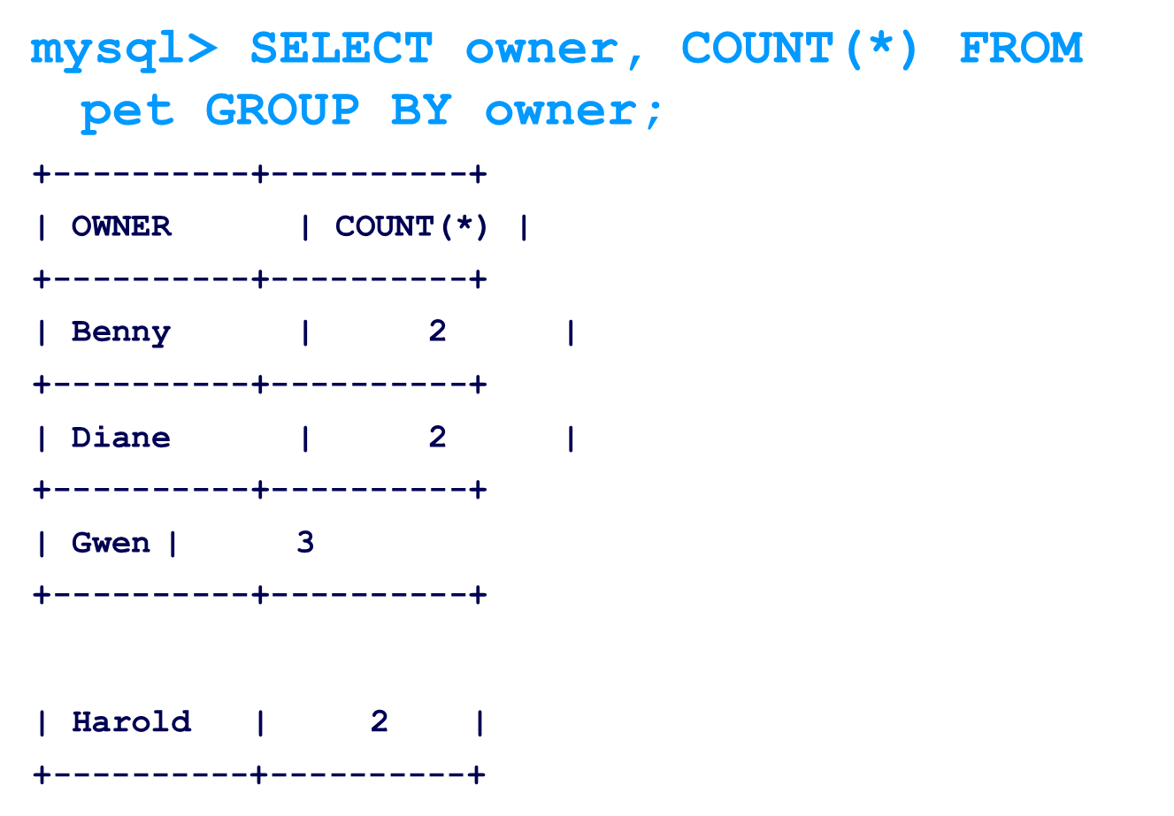
Counting Rows Example
Finding how many pets each owner has:

Slide 80
Selecting Particular Rows
Find out number of animals per species
SELECT species, count(*) FROM pet GROUP BY species;
Find out number of animals per gender
SELECT gender, count(*) FROM pet GROUP BY gender;
Find out number of animals per combination of species and gender
SELECT species, gender, count(*) FROM pet GROUP BY species, gender;

Slide 81
Selecting Particular Rows
Find out number of dogs and cats per combination of species and gender
SELECT species, gender, count(*) FROM pet WHERE species = 'dog' or species = 'cat' GROUP BY species, gender;
Try what happens changing OR with AND
Find out number of animals per gender only for animals whose gender is known
SELECT species, gender, count(*) FROM pet WHERE gender IS NOT NULL GROUP BY species, gender;

Slide 82
Batch Mode
MySQL used interactively
to enter queries and view the results.
MySQL can be run in batch mode.
put the commands you want to run in a file, then tell mysql to read its input from the file:
The created file is script file that is requested to be executed
shell> mysql < batch-file
shell> mysql -t < batch-file

Slide 83
Exercise 1
Create a new DB or a table shop in an existing DB
CREATE TABLE shop (
article INT(4) UNSIGNED ZEROFILL DEFAULT '0000' NOT NULL,
dealer VARCHAR(20) DEFAULT '' NOT NULL, price DOUBLE(16,2) DEFAULT '0.00' NOT NULL,
PRIMARY KEY(article, dealer));
INSERT INTO shop VALUES (1,'A',3.45),(1,'B',3.99),(2,'A',10.99),
(3,'B',1.45),
(3,'C',1.69),(3,'D',1.25),(4,'D',19.95);

Slide 84
Exercise 1
Find out the highest item article
SELECT MAX(article) AS article FROM shop;
Find the article, dealer, and price of the most expensive article.
SELECT article, dealer, price FROM shop
WHERE price=(SELECT MAX(price) FROM shop);
SELECT article, dealer, price FROM shop
ORDER BY price DESC LIMIT 1;

Slide 85
Exercise 1
Find the highest price per article.
SELECT article, MAX(price) AS price FROM shop
GROUP BY article;
For each article, find the dealer(s)with the most expensive price.
SELECT article, dealer, price FROM shop s1
WHERE price=(SELECT MAX(s2.price)
FROM shop s2
WHERE s1.article = s2.article);

Slide 86
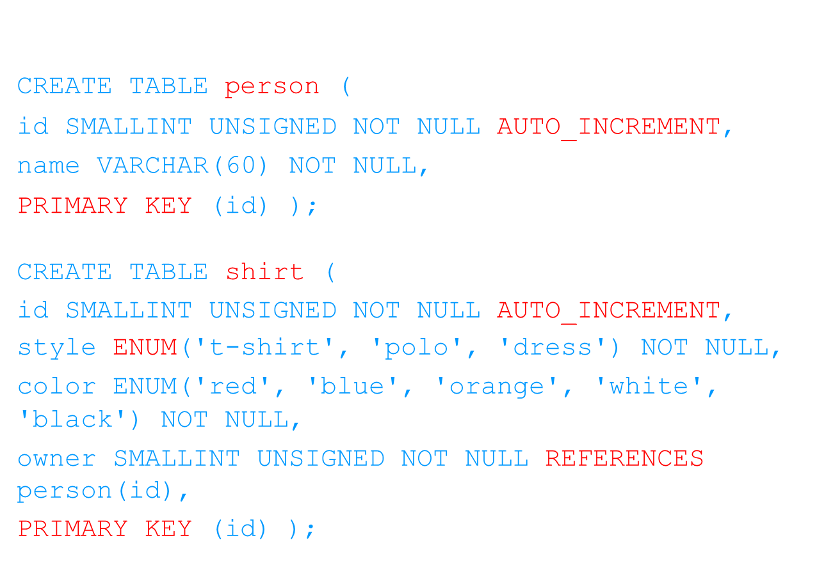
Exercise 2
Create the following table:

Slide 87
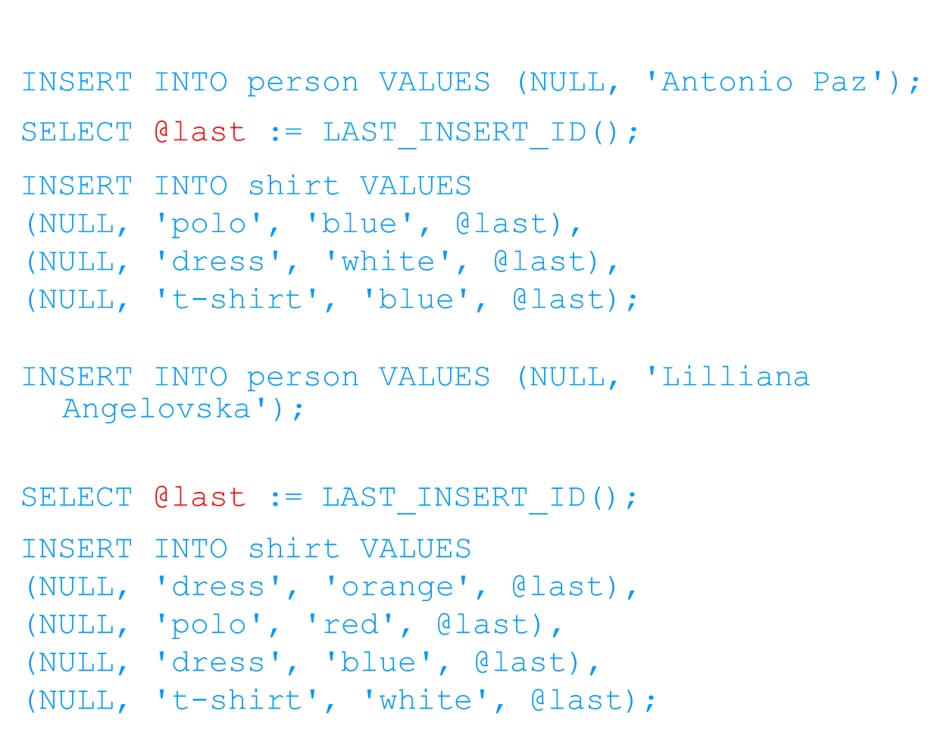
Exercise 2

Slide 88
Exercise 2
Find out person names containing “Lilliana” as a string and having a shirt of any color but not white
SELECT s.*
FROM person p INNER JOIN shirt s ON s.owner = p.id
WHERE p.name LIKE '%Lilliana%' AND s.color <> 'white';

Slide 89


Slide 90
Content
1: Introduction & Basics
2: CRUD Operations
3: Administration
4: Scalability and Availability
5: Indexes and Aggregation
6: MongoDB Security Risks
Notes:
Audio Script:
GD Instruction:

Slide 91
Introduction and Basics

Slide 92
History
mongoDB = “Humongous DB”
Open-source
Document-based
“High performance, high availability”
Automatic scaling
C-P on CAP
blog.mongodb.org/post/475279604/on-distributed-consistency-part-1
-mongodb.org/manual
Notes:
Audio Script:
GD Instruction:

Slide 93
Data Base
A database is an organized collection of structured information, or data, typically stored electronically in a computer system.
A database is usually controlled by a database management system (DBMS).
Data within the most common types of databases in operation today is typically modeled in rows and columns in a series of tables to make processing and data querying efficient.
The data can then be easily accessed, managed, modified, updated, controlled, and organized. Most databases use structured query language (SQL) for writing and querying data.
Notes:
Audio Script:
GD Instruction:

Slide 94
Relational Database
A relational database management system (RDBMS) stores and retrieves data that is represented in tables.
A relational database consists of a collection of tables that store interrelated data.
In a relational database, all data is held in tables, which are made up of rows and columns.
Each table has one or more columns, and each column is assigned a specific datatype, such as an integer number, a sequence of characters (for text), or a date. Each row in the table has a value for each column.
Notes:
Audio Script:
GD Instruction:

Slide 95
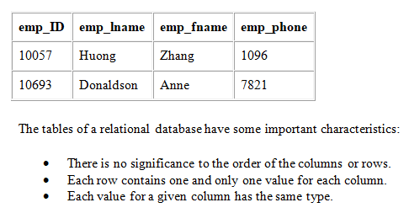
A typical fragment of a table containing employee information may look as follows:
Notes:
Audio Script:
GD Instruction:

Slide 96
What is N0SQL?
NoSQL encompasses a wide variety of different database technologies that were developed in response to the demands presented in building modern applications.
Developers are working with applications that create massive volumes of new, rapidly changing data types — structured, semi-structured, unstructured and polymorphic data.
Notes:
Audio Script:
GD Instruction:

Slide 97
Where to use NOSQL?
Although NoSQL databases can vary greatly in features and benefits, most offer greater data model flexibility, horizontal scalability, and superior performance over relational databases.
We use it if:
Need to handle large volumes of structured, semi-structured, and unstructured data
Follow modern development practices such as agile sprints, quick iterations, and frequent code pushes
Prefer object-oriented programming that is easy to use and flexible
Want to leverage efficient, scale-out architecture instead of expensive, monolithic architecture
Notes:
Audio Script:
GD Instruction:

Slide 98
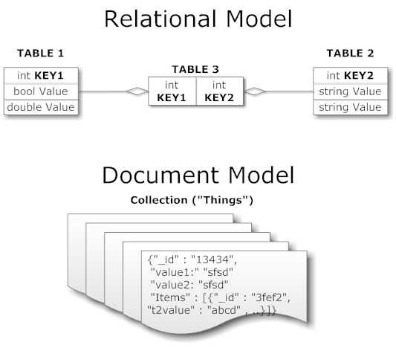
Other NoSQL Types
Key/value (Dynamo)
Columnar/tabular (HBase)
Document (mongoDB)
http://www.aaronstannard.com/post/2011/06/30/MongoDB-vs-SQL-Server.aspx
Notes:
Audio Script:
GD Instruction:

Slide 99
Motivations
Problems with SQL
Rigid schema
Not easily scalable (designed for 90’s technology or worse)
Requires unintuitive joins
Perks of mongoDB
Easy interface with common languages (Java, Javascript, PHP, etc.)
DB tech should run anywhere (VM’s, cloud, etc.)
Keeps essential features of RDBMS’s while learning from key-value noSQL systems
http://www.slideshare.net/spf13/mongodb-9794741?v=qf1&b=&from_search=13
Notes:
Audio Script:
GD Instruction:

Slide 100

Company Using mongoDB
“MongoDB powers Under Armour’s online store, and was chosen for its dynamic schema, ability to scale horizontally and perform multi-data center replication.”
http://www.mongodb.org/about/production-deployments/
Notes:
Audio Script:
GD Instruction:

Slide 101
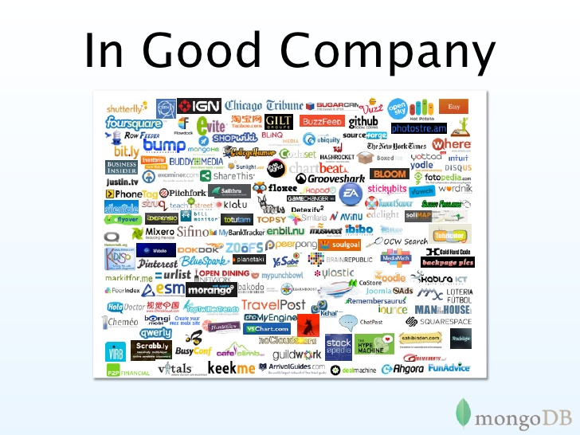
-Steve Francia, http://www.slideshare.net/spf13/mongodb-9794741?v=qf1&b=&from_search=13
Notes:
Audio Script:
GD Instruction:

Slide 102
Data Model
Document-Based (max 16 MB)
Documents are in BSON format, consisting of field-value pairs
Each document stored in a collection
Collections
Have index set in common
Like tables of relational db’s.
Documents do not have to have uniform structure
-docs.mongodb.org/manual/
Notes:
Audio Script:
GD Instruction:

Slide 103
JSON
“JavaScript Object Notation”
Easy for humans to write/read, easy for computers to parse/generate
Objects can be nested
Built on
name/value pairs
Ordered list of values
http://json.org/
Notes:
Audio Script:
GD Instruction:

Slide 104
BSON
“Binary JSON”
Binary-encoded serialization of JSON-like docs
Also allows “referencing”
Embedded structure reduces need for joins
Goals
Lightweight
Traversable
Efficient (decoding and encoding)
http://bsonspec.org/
Notes:
Audio Script:
GD Instruction:

Slide 105
BSON Example
{
"_id" : "37010"
"city" : "ADAMS",
"pop" : 2660,
"state" : "TN",
“councilman” : {
name: “John Smith”
address: “13 Scenic Way”
}
}
Notes:
Audio Script:
GD Instruction:

Slide 106
BSON Types
Type | Number
Double | 1
String | 2
Object | 3
Array | 4
Binary data | 5
Object id | 7
Boolean | 8
Date | 9
Null | 10
Regular Expression | 11
JavaScript | 13
Symbol | 14
JavaScript (with scope) | 15
32-bit integer | 16
Timestamp | 17
64-bit integer | 18
Min key | 255
Max key | 127
The number can be used with the $type operator to query by type!
Notes:
Audio Script:
GD Instruction:

Slide 107
The _id Field
By default, each document contains an _id field. This field has a number of special characteristics:
Value serves as primary key for collection.
Value is unique, immutable, and may be any non-array type.
Default data type is ObjectId, which is “small, likely unique, fast to generate, and ordered.” Sorting on an ObjectId value is roughly equivalent to sorting on creation time.
http://docs.mongodb.org/manual/reference/bson-types/

Slide 108
mongoDB vs. SQL
mongoDB | SQL
Document | Tuple
Collection | Table/View
PK: _id Field | PK: Any Attribute(s)
Uniformity not Required | Uniform Relation Schema
Index | Index
Embedded Structure | Joins
Shard | Partition

Slide 109
Overview of MONGODB
MongoDB is an open-source document database that provides high performance, high availability, and automatic scaling.

Slide 110
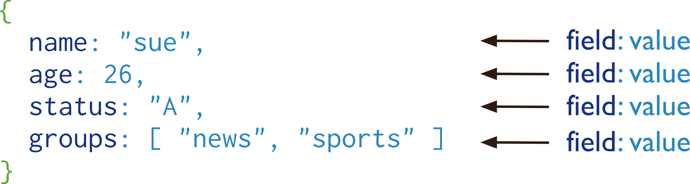
Document Database
A record in MongoDB is a document, which is a data structure composed of field and value pairs. MongoDB docu- ments are similar to JSON objects. The values of fields may include other documents, arrays, and arrays of documents.

Slide 111
Key Features MongoDB
High Performance
MongoDB provides high performance data persistence.
High Availability
MongoDB’s replication facility, called replica sets, provide:
automatic failover.
data redundancy.
Automatic Scaling
MongoDB provides horizontal scalability as part of its core functionality

Slide 112
MongoDB Installation

Slide 113
Getting Started with mongoDB
To install mongoDB, go to this link and click on the appropriate OS and architecture: http://www.mongodb.org/downloads
First, extract the files (preferrably to the C drive).
Finally, create a data directory on C:\ for mongoDB to use
i.e. “md data” followed by “md data\db”
http://docs.mongodb.org/manual/tutorial/install-mongodb-on-windows/

Slide 114
Getting Started with mongoDB
Open your mongodb/bin directory and run mongod.exe to start the database server.
To establish a connection to the server, open another command prompt window and go to the same directory, entering in mongo.exe. This engages the mongodb shell—it’s that easy!
http://docs.mongodb.org/manual/tutorial/getting-started/

Slide 115
CRUD Operations
Create, Read, Update, Delete

Slide 116
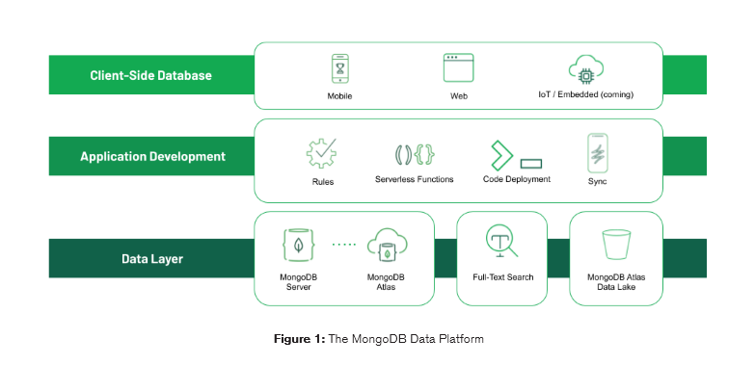
MongoDB Architecture

Slide 117
The MongoDB Data Platform
Data Layer
Application Development
Client-Side Database

Slide 118
MongoDB Production Cluster Architecture
In a production cluster, you must ensure that data is redundant and that your systems are highly available.
To that end, a production cluster must have the following components:
Config Servers
A single sharded cluster must have exclusive use of its config servers. If you have multiple sharded clusters, each cluster must have its own replica set config servers.
Two or More Replica Sets As Shards
These replica sets are the shards.
One or More Query Routers (mongos)
The mongos instances are the routers for the cluster. Typically, deployments have one mongos instance on each application server.

Slide 120
MongoDB CRUD Introduction
MongoDB stores data in the form of documents, which are JSON-like field and value pairs.
Documents are analogous to structures in programming languages that associate keys with values (e.g. dictionaries, hashes, maps, and associative arrays).
Formally, MongoDB documents are BSON documents.
BSON is a binary representation of JSON with additional type information.
In the documents, the value of a field can be any of the BSON data types, including other documents, arrays, and arrays of documents.

Slide 121
Example

Slide 122
Collection
MongoDB stores all documents in collections.
A collection is a group of related documents that have a set of shared common indexes.
Collections are analogous to a table in relational databases.

Slide 123
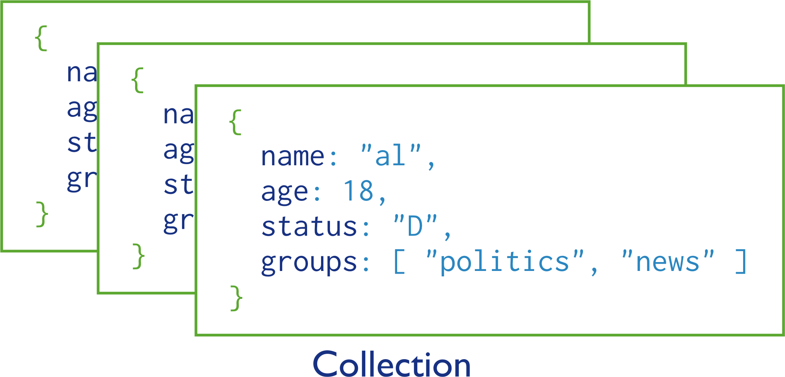
Example

Slide 124
Query
In MongoDB a query targets a specific collection of documents.
Queries specify criteria, or conditions, that identify the documents that MongoDB returns to the clients.
A query may include a projection that specifies the fields from the matching documents to return.
You can optionally modify queries to impose limits, skips, and sort orders.

Slide 125
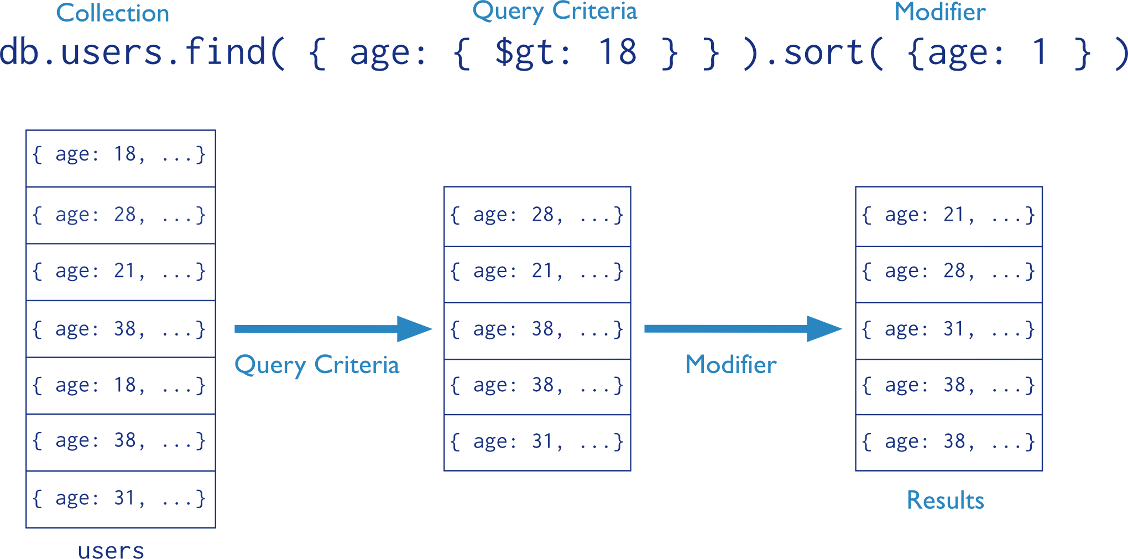
In the following diagram, the query process specifies a query criteria and a sort modifier:

Slide 126
Data Modification
Data modification refers to operations that create, update, or delete data.
In MongoDB, these operations modify the data of a single collection.
For the update and delete operations, you can specify the criteria to select the documents to update or remove.

Slide 127
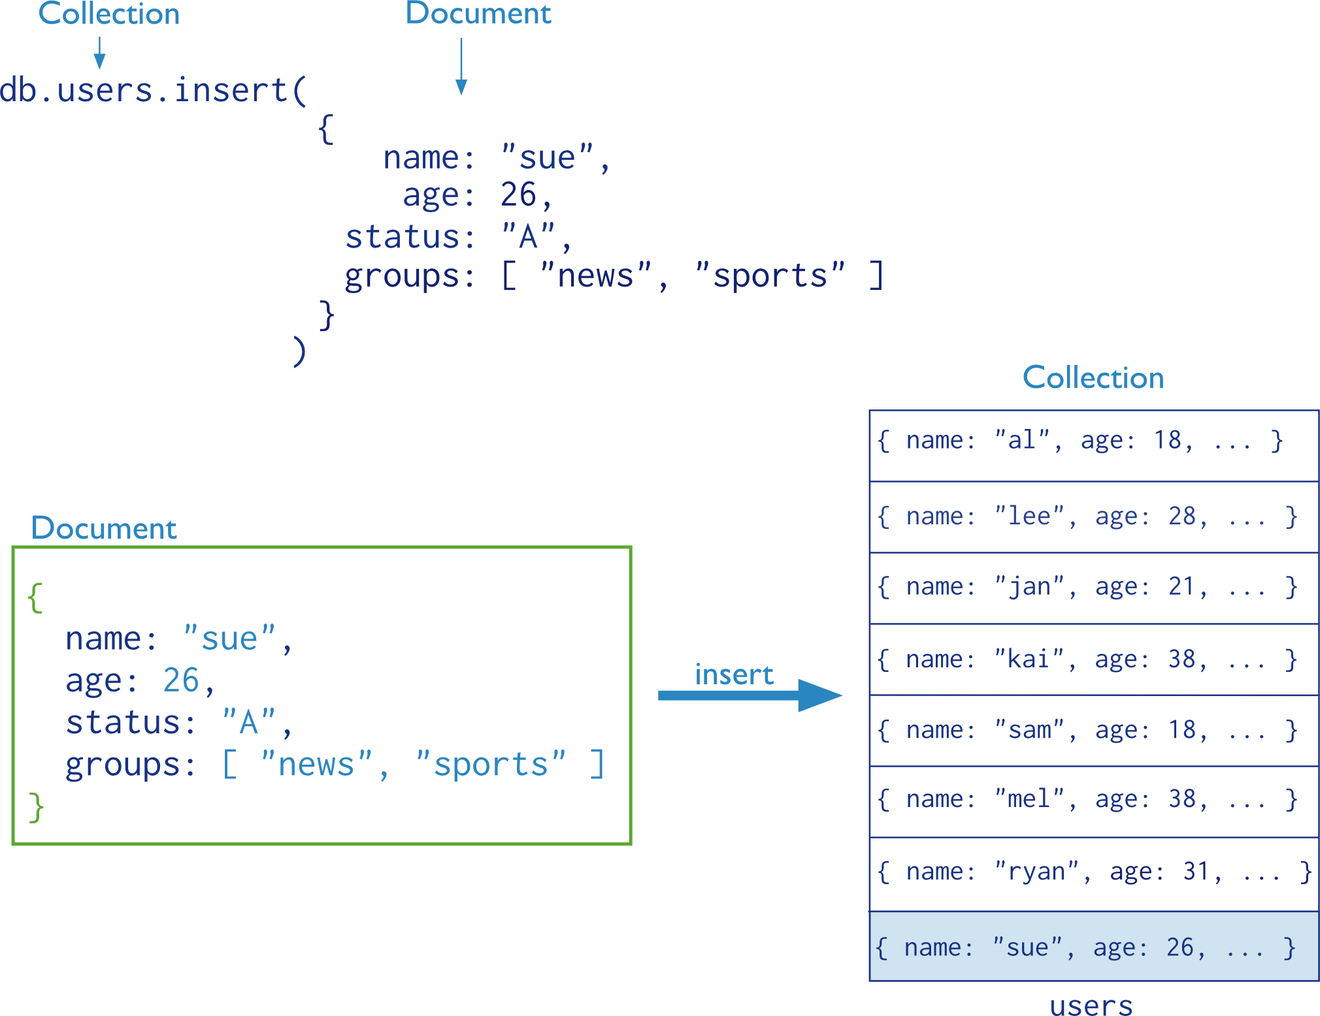
In the following diagram, the insert operation adds a new document to the user’s collection.

Slide 128
MongoDB CRUD Concepts
The Read Operations and Write Operations documents introduce the behavior and operations of read and write operations for MongoDB deployments.
Read Operations Queries are the core operations that return data in MongoDB. Introduces queries, their behavior, and performances.
Write Operations Write operations insert, update, or remove documents in MongoDB. Introduces data create and modify operations, their behavior, and performances.

Slide 129
Read Operations Overview
Read operations, or queries, retrieve data stored in the database. In MongoDB, queries select documents from a single
collection.
Queries specify criteria, or conditions, that identify the documents that MongoDB returns to the clients. A query may include a projection that specifies the fields from the matching documents to return. The projection limits the amount of data that MongoDB returns to the client over the network.

Slide 130
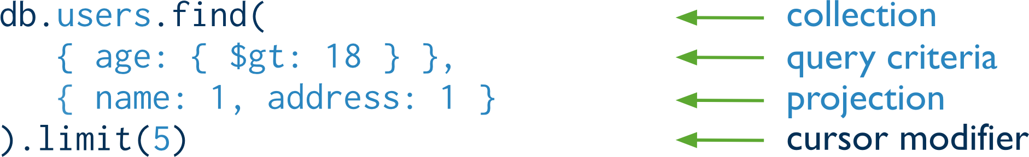
Query Interface
For query operations, MongoDB provides a db.collection.find() method. The method accepts both the query criteria and projections and returns a cursor to the matching documents. You can optionally modify the query to impose limits, skips, and sort orders.
The following diagram highlights the components of a MongoDB query operation:
db.users.find( { age: { $gt: 18 } }, { name: 1, address: 1 } ).limit(5

Slide 131

The diagram shows the MongoDB query in SQL:

Slide 132
Write Operations Overview
A write operation is any operation that creates or modifies data in the MongoDB instance.
In MongoDB, write operations target a single collection.
All write operations in MongoDB are atomic on the level of a single document.
There are three classes of write operations in MongoDB: insert , update , and remove .

Slide 133
CRUD: Using the Shell
To check which db you’re using db
Show all databases show dbs
Switch db’s/make a new one use <name>
See what collections exist show collections
Note: db’s are not actually created until you insert data!

Slide 134
CRUD: Using the Shell (cont.)
To insert documents into a collection/make a new collection:
db.<collection>.insert(<document>)
<=>
INSERT INTO <table>
VALUES(<attributevalues>);

Slide 135
CRUD: Inserting Data
Insert one document
db.<collection>.insert({<field>:<value>})
Inserting a document with a field name new to the collection is inherently supported by the BSON model.
To insert multiple documents, use an array.

Slide 136
CRUD: Querying
Done on collections.
Get all docs: db.<collection>.find()
Returns a cursor, which is iterated over shell to display first 20 results.
Add .limit(<number>) to limit results
SELECT * FROM <table>;
Get one doc: db.<collection>.findOne()

Slide 137
CRUD: Querying
To match a specific value:
db.<collection>.find({<field>:<value>})
“AND”
db.<collection>.find({<field1>:<value1>,
<field2>:<value2>
})
SELECT *
FROM <table>
WHERE <field1> = <value1> AND <field2> = <value2>;

Slide 138
CRUD: Querying
OR
db.<collection>.find({ $or: [
<field>:<value1>
<field>:<value2> ]
})
SELECT *
FROM <table> WHERE <field> = <value1> OR <field> = <value2>;
Checking for multiple values of same field
db.<collection>.find({<field>: {$in [<value>, <value>]}})

Slide 139
CRUD: Querying
Including/excluding document fields
db.<collection>.find({<field1>:<value>}, {<field2>: 0})
SELECT field1
FROM <table>;
db.<collection>.find({<field>:<value>}, {<field2>: 1})
Find documents with or w/o field
db.<collection>.find({<field>: { $exists: true}})

Slide 140
CRUD: Updating
db.<collection>.update(
{<field1>:<value1>}, //all docs in which field = value
{$set: {<field2>:<value2>}}, //set field to value
{multi:true} ) //update multiple docs
upsert: if true, creates a new doc when none matches search criteria.
UPDATE <table> SET <field2> = <value2>
WHERE <field1> = <value1>;

Slide 141
CRUD: Updating
To remove a field
db.<collection>.update({<field>:<value>},
{ $unset: { <field>: 1}})
Replace all field-value pairs
db.<collection>.update({<field>:<value>},
{ <field>:<value>, <field>:<value>})
*NOTE: This overwrites ALL the contents of a document, even removing fields.

Slide 142
CRUD: Removal
Remove all records where field = value
db.<collection>.remove({<field>:<value>})
DELETE FROM <table>
WHERE <field> = <value>;
As above, but only remove first document
db.<collection>.remove({<field>:<value>}, true)

Slide 143


Slide 144
Content
1: Introduction to PostgreSQL
2: PostgreSQL System Architecture
3: Creating and Managing Database
4: PostgreSQL Data Dictionary
5: Configuration
6: Security
7: Backup and Recovery & Point-in Time Recovery
8: Routine Maintenance
9: Table Partitioning
10: Database Monitoring

Slide 145
Introduction to PostgreSQL

Slide 146
What is PostgreSQL?
PostgreSQL is a general purpose and object-relational database management system, the most advanced open source database system.
PostgreSQL was developed based on POSTGRES 4.2 at Berkeley Computer Science Department, University of California.
PostgreSQL was designed to run on UNIX-like platforms.
However, PostgreSQL was then also designed to be portable so that it could run on various platforms such as Mac OS X, Solaris, and Windows.
PostgreSQL is free and open source software.

Slide 147
What is PostgreSQL?
Its source code is available under PostgreSQL license, a liberal open source license.
You are free to use, modify and distribute PostgreSQL in any form.
PostgreSQL requires very minimum maintained efforts because of its stability.
Therefore, if you develop applications based on PostgreSQL, the total cost of ownership is low in comparison with other database management systems.

Slide 148
PostgreSQL features highlights
PostgreSQL has many advanced features that other enterprise database management systems offer, such as:
User-defined types
Table inheritance
Sophisticated locking mechanism
Foreign key referential integrity
Views, rules, subquery
Nested transactions (savepoints)
Multi-version concurrency control (MVCC)
Asynchronous replication
The recent versions of PostgreSQL support the following features:
Native Microsoft Windows Server version
Tablespaces
Point-in-time recovery

Slide 149
A Brief History of PostgreSQL
1977-1985 − A project called INGRES was developed.
Proof-of-concept for relational databases
Established the company Ingres in 1980
Bought by Computer Associates in 1994
1986-1994 − POSTGRES
Development of the concepts in INGRES with a focus on object orientation and the query language - Quel
The code base of INGRES was not used as a basis for POSTGRES
Commercialized as Illustra (bought by Informix, bought by IBM)
1994-1995 − Postgres95
Support for SQL was added in 1994
Released as Postgres95 in 1995
Re-released as PostgreSQL 6.0 in 1996
Establishment of the PostgreSQL Global Development Team

Slide 150
Key Features of PostgreSQL
PostgreSQL supports a large part of the SQL standard and offers many modern features including the following −
Complex SQL queries
SQL Sub-selects
Foreign keys
Trigger
Views
Transactions
Multiversion concurrency control (MVCC)
Streaming Replication (as of 9.0)
Hot Standby (as of 9.0)
PostgreSQL can be extended by the user in many ways. For example by adding new −
Data types
Functions
Operators
Aggregate functions
Index methods

Slide 151
Creating and Managing Databases

Slide 152
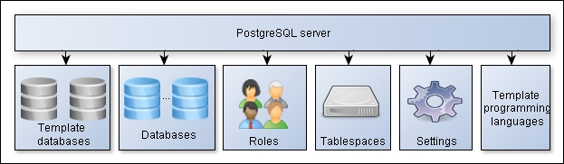
PostgreSQL objects hierarchy
Understanding the organization of PostgreSQL database logical objects helps in understanding object relations and interactions.
PostgreSQL databases, roles, tablespaces, settings, and template languages have the same level of hierarchy, as shown in the following diagram:

Slide 153
Creating a Database
In order to create a database, the PostgreSQL server must be up and running.
Databases are created with the SQL command CREATE DATABASE:
CREATE DATABASE name;

Slide 154
Destroying a Database
Databases are destroyed with the command DROP DATABASE:
DROP DATABASE name;

Slide 155


thank you!
Copyright © Knowledgehut., All rights reserved
Confidential Information, intended for approved distribution list of Knowledgehut

